Slide 1

Decision-Making: The Essence of the Manager’s Job
Chapter
7
© 2007 Prentice Hall, Inc.
All rights reserved.

Slide 2
L E A R N I N G O U T L I N E
Follow this Learning Outline as you read and study this chapter.
The Decision-Making Process
  Define decision and decision-making process.
  Describe the eight steps in the decision-making process.
The Manager as Decision Maker
  Discuss the assumptions of rational decision making.
  Describe the concepts of bounded rationality, satisficing, and escalation of commitment.
  Explain intuitive decision making.
  Contrast programmed and nonprogrammed decisions.
© 2007 Prentice Hall, Inc. All rights reserved.
6–<number>

Slide 3
L E A R N I N G O U T L I N E (cont’d)
Follow this Learning Outline as you read and study this chapter.
The Manager as Decision Maker (cont’d)
  Contrast the three decision-making conditions.
  Explain maximax, maximin, and minimax decision choice approaches.
  Describe the four decision making styles.
  Discuss the twelve decision-making biases managers may exhibit.
  Describe how manager can deal with the negative effects of decision errors and biases.
  Explain the managerial decision-making model.
© 2007 Prentice Hall, Inc. All rights reserved.
6–<number>

Slide 4
L E A R N I N G O U T L I N E (cont’d)
Follow this Learning Outline as you read and study this chapter.
Decision Making for Today’s World
  Explain how managers can make effective decisions in today’s world.
  List six characteristics of an effective decision-making process.
  Describe the five habits of highly reliable organizations.
© 2007 Prentice Hall, Inc. All rights reserved.
6–<number>

Slide 5
How to improve decision making skills
Decision:
“Making a choice from two or more alternatives”
Know, understand, and use the decision-making process.
Know when and how to use rational or intuitive decision making or both.
Know your decision-making style.
Know, recognize, and understand the biases and errors that may influence your decision making!
A key to success in management and in your career is knowing how to be an effective decision maker.
1–<number>

Slide 6
✅ Example: DECISION MAKING PROCESS
Scenario: You're trying to decide which university to attend.
1. Identify the problem: You need to choose a university that fits your goals.
2. Gather info: Research university rankings, costs, programs, locations, etc.
3. Generate alternatives: List 3–5 potential schools.
4. Weigh the evidence: Compare pros and cons of each (e.g., costs, reputation).
5. Choose: Select the best fit.
6.Take action: Apply and accept the offer.
7. Review: After a year, evaluate if the decision was good—do you feel you belong?
© 2007 Prentice Hall, Inc. All rights reserved.
1–<number>

Slide 7
Decision Making
The Decision-Making Process
  Identifying a problem and decision criteria and allocating weights to the criteria.
  Developing, analyzing, and selecting an alternative that can resolve the problem.
  Implementing the selected alternative.
  Evaluating the decision’s effectiveness.
Criteria: Criteria that define what’s important or relevant to resolving a problem
© 2007 Prentice Hall, Inc. All rights reserved.
6–<number>

Slide 8
Step 1: Identifying the Problem
Problem
“An obstacle that makes it difficult to achieve a desired goal or purpose”.
Characteristics of Problems
  A problem becomes a problem when a manager becomes aware of it.
  There is pressure to solve the problem.
  The manager must have the authority, information, or resources needed to solve the problem.
© 2007 Prentice Hall, Inc. All rights reserved.
6–<number>

Slide 9
Step 2: Identifying Decision Criteria
Decision criteria are factors that are important (relevant) to resolving the problem.
  Costs that will be incurred (investments required)
  Risks likely to be encountered (chance of failure)
  Outcomes that are desired (growth of the firm)
Step 3: Allocating Weights to the Criteria
Decision criteria are not of equal importance:
  Assigning a weight to each item places the items in the correct priority order of their importance in the decision making process.
© 2007 Prentice Hall, Inc. All rights reserved.
6–<number>

Slide 10
Step 4: Developing Alternatives
Identifying viable alternatives
  Alternatives are listed (without evaluation) that can resolve the problem.
Step 5: Analyzing Alternatives
Appraising each alternative’s strengths and weaknesses
  An alternative’s appraisal is based on its ability to resolve the issues identified in steps 2 and 3.
© 2007 Prentice Hall, Inc. All rights reserved.
6–<number>

Slide 11
Step 6: Selecting an Alternative
Choosing the best alternative
  The alternative with the highest total weight is chosen.
Step 7: Implementing the Alternative
Putting the chosen alternative into action.
  Conveying the decision to and gaining commitment from those who will carry out the decision.
© 2007 Prentice Hall, Inc. All rights reserved.
6–<number>

Slide 12
Step 8: Evaluating the Decision’s Effectiveness
The soundness of the decision is judged by its outcomes.
  How effectively was the problem resolved by outcomes resulting from the chosen alternatives?
  If the problem was not resolved, what went wrong?
© 2007 Prentice Hall, Inc. All rights reserved.
6–<number>

Slide 13
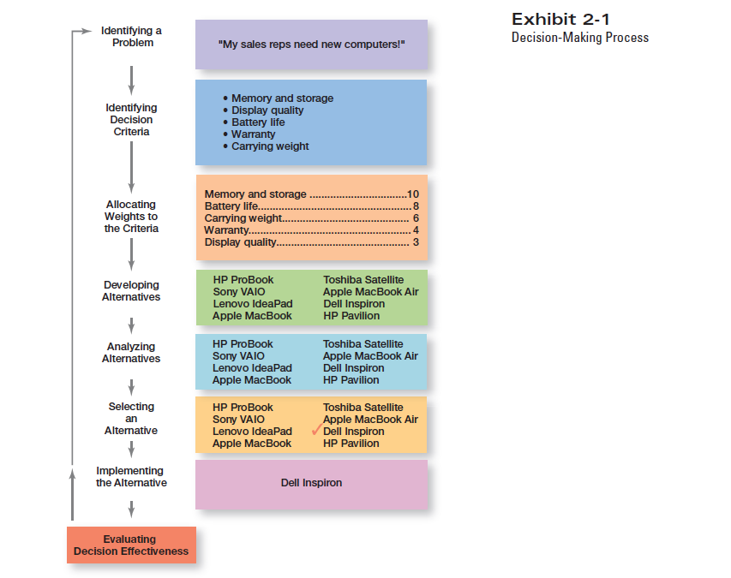
Exhibit 6–1
The Decision-Making Process
© 2007 Prentice Hall, Inc. All rights reserved.
6–<number>

Slide 14
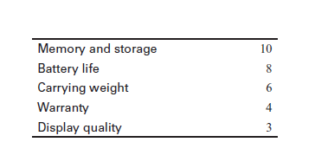
Exhibit 6–2 Criteria and Weights for Computer Replacement Decision
© 2007 Prentice Hall, Inc. All rights reserved.
6–<number>

Slide 15
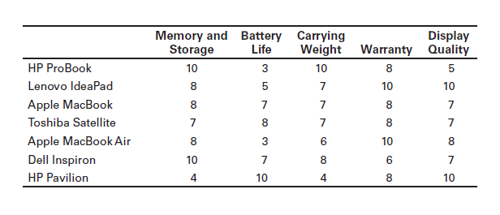
Exhibit 6–3 Assessed Values of Laptop Computers Using Decision Criteria
© 2007 Prentice Hall, Inc. All rights reserved.
6–<number>

Slide 16
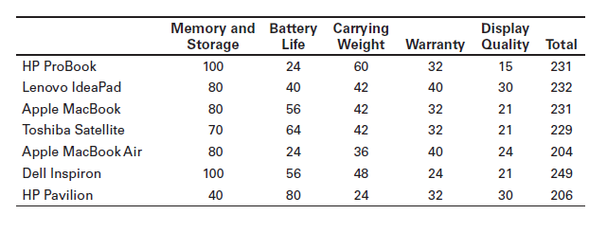
Exhibit 6–4 Evaluation of Laptop Alternatives Against Weighted Criteria
© 2007 Prentice Hall, Inc. All rights reserved.
6–<number>

Slide 17
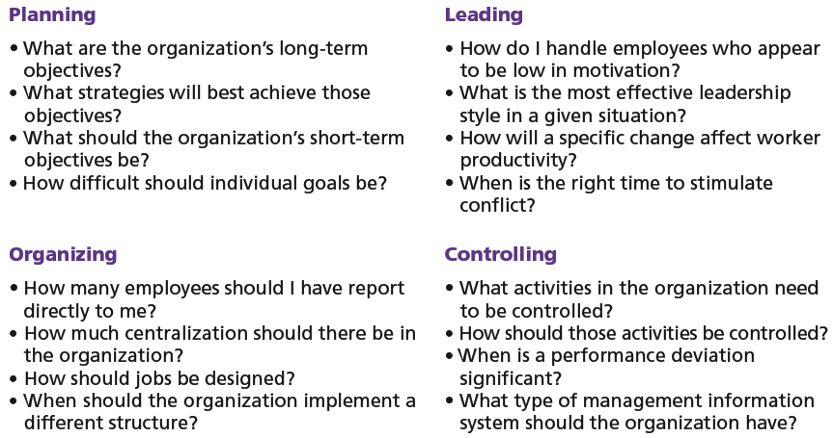
Exhibit 6–5 Decisions in the Management Functions
© 2007 Prentice Hall, Inc. All rights reserved.
6–<number>

Slide 18
Making Decisions
Rationality
What is Rationality?
Rationality means that managers make smart, logical decisions that help the company get the best results.
  Managers make consistent, value-maximizing choices with specified constraints.
  Assumptions are that decision makers:
    Are perfectly rational, fully objective, and logical.
    Have carefully defined the problem and identified all viable alternatives.
    Have a clear and specific goal
    Will select the alternative that maximizes outcomes in the organization’s interests rather than in their personal interests.
© 2007 Prentice Hall, Inc. All rights reserved.
6–<number>

Slide 19
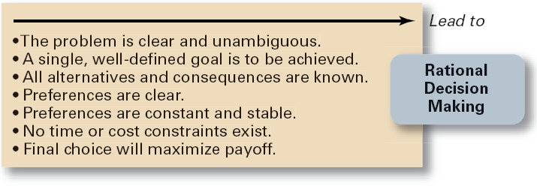
Exhibit 6–6 Assumptions of Rationality
© 2007 Prentice Hall, Inc. All rights reserved.
6–<number>

Slide 20
Making Decisions (cont’d)
Bounded Rationality
What is Bounded Rationality?
Bounded Rationality means that managers try to make good decisions, but they are limited by things like:
Not having all the information
Not enough time
Not being able to analyze every possible choice
So, even though they want to make the best choice, they can’t consider everything perfectly.
  Assumptions are that decision makers:
    Will not seek out or have knowledge of all alternatives
    Will satisfice—choose the first alternative encountered that satisfactorily solves the problem—rather than maximize the outcome of their decision by considering all alternatives and choosing the best.
  Influence on decision making
    Escalation of commitment: an increased commitment to a previous decision despite evidence that it may have been wrong.
© 2007 Prentice Hall, Inc. All rights reserved.
6–<number>

Slide 21
The Role of Intuition
Intuitive decision making
  Making decisions on the basis of experience, feelings, and accumulated judgment.
© 2007 Prentice Hall, Inc. All rights reserved.
6–<number>

Slide 22
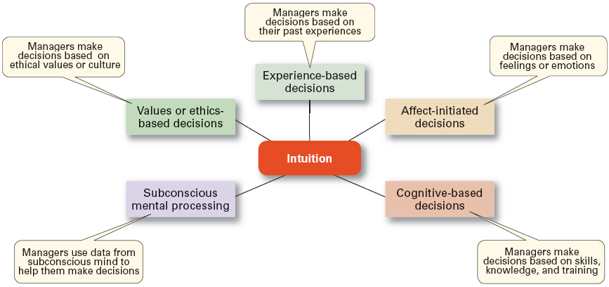
Exhibit 6–7 What is Intuition?
Source: Based on L. A. Burke and M. K. Miller, “Taking the Mystery Out of Intuitive Decision Making,” Academy of Management Executive, October 1999, pp. 91–99.
© 2007 Prentice Hall, Inc. All rights reserved.
6–<number>

Slide 23
Types of Problems and Decisions
Structured Problems
  Involve goals that clear.
  Are familiar (have occurred before).
  Are easily and completely defined—information about the problem is available and complete.
Programmed Decision
  A repetitive decision that can be handled by a routine approach.
© 2007 Prentice Hall, Inc. All rights reserved.
6–<number>

Slide 24
Types of Programmed Decisions
Policy
  A general guideline for making a decision about a structured problem.
Procedure
  A series of interrelated steps that a manager can use to respond (applying a policy) to a structured problem.
Rule
  An explicit statement that limits what a manager or employee can or cannot do.
© 2007 Prentice Hall, Inc. All rights reserved.
6–<number>

Slide 25
Policy, Procedure, and Rule Examples
Policy
  Accept all customer-returned merchandise.
Procedure
  Follow all steps for completing merchandise return documentation.
Rules
  Managers must approve all refunds over $50.00.
  No credit purchases are refunded for cash.
© 2007 Prentice Hall, Inc. All rights reserved.
6–<number>

Slide 26
Problems and Decisions (cont’d)
Unstructured Problems
  Problems that are new or unusual and for which information is ambiguous or incomplete.
  Problems that will require custom-made solutions.
Nonprogrammed Decisions
  Decisions that are unique and nonrecurring.
  Decisions that generate unique responses.
© 2007 Prentice Hall, Inc. All rights reserved.
6–<number>

Slide 27
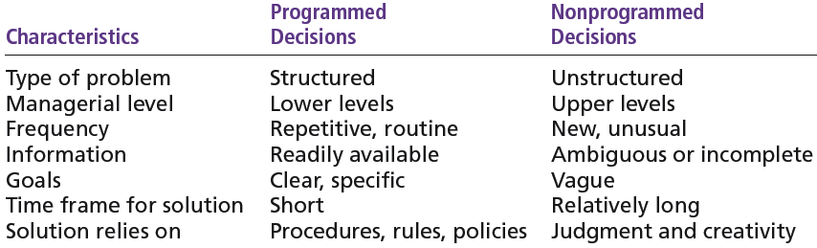
Exhibit 6–8 Programmed versus Nonprogrammed Decisions
© 2007 Prentice Hall, Inc. All rights reserved.
6–<number>

Slide 28
Decision-Making Conditions
Certainty
  A situation in which a manager can make an accurate decision because the outcome of every alternative choice is known.
Risk
  A situation in which the manager is able to estimate the likelihood (probability) of outcomes that result from the choice of particular alternatives.
© 2007 Prentice Hall, Inc. All rights reserved.
6–<number>

Slide 29
Exhibit 6–9 Expected Value for Revenues from the Addition of One Ski Lift
What is "Expected Value"?
Expected Value is a way to make decisions under uncertainty.
It combines the possible outcomes with the probability
of each one happening.
Formula:
Expected Value (EV) = Σ (Probability × Expected Revenue)
Expected
Expected × Probability = Value of Each
Event Revenues Alternative
Heavy snowfall $850,000 0.3 = $255,000
Normal snowfall 725,000 0.5 = 362,500
Light snowfall 350,000 0.2 = 70,000
$687,500
© 2007 Prentice Hall, Inc. All rights reserved.
6–<number>

Slide 30
Decision-Making Conditions
Uncertainty
🧠 What is Uncertainty?
Uncertainty means you don’t know what will happen — and you can’t even guess probabilities.
Managers don’t have enough data to predict which outcome is more likely. So, they rely on decision-making styles based on their personality or strategy.
Maximax: the optimistic manager’s choice to maximize the maximum payoff
Maximin: the pessimistic manager’s choice to maximize the minimum payoff
Minimax: the manager’s choice to minimize maximum regret.
© 2007 Prentice Hall, Inc. All rights reserved.
6–<number>

Slide 31
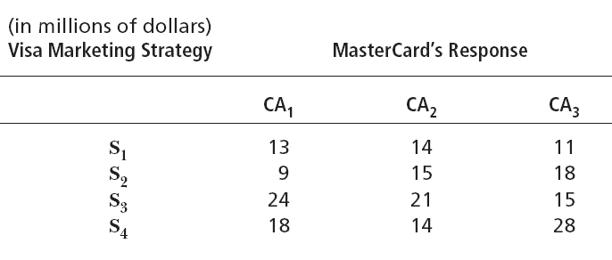
Exhibit 6–10 Payoff Matrix
© 2007 Prentice Hall, Inc. All rights reserved.
6–<number>

Slide 32
Three Ways to Decide Under Uncertainty
1. Maximax Approach (Optimistic)
The most optimistic decision-maker.
Looks for the maximum possible gain in each strategy.
Then chooses the strategy with the biggest of those gains.
Step-by-step:
Max of S₁ = 14
Max of S₂ = 18
Max of S₃ = 24
Max of S₄ = 28 → Choose S₄
✅ Visa chooses S₄ because $28M is the highest possible profit.
© 2007 Prentice Hall, Inc. All rights reserved.
1–<number>

Slide 33
2.Maximin Approach (Pessimistic)
Assumes the worst will happen.
Looks at the minimum payoff for each strategy.
Then chooses the strategy with the largest of min payoff.
Step-by-step:
Min of S₁ = 11
Min of S₂ = 9
Min of S₃ = 15
Min of S₄ = 14 → Choose S₃
✅ Visa chooses S₃ because even in the worst case, it earns at least $15M.
© 2007 Prentice Hall, Inc. All rights reserved.
1–<number>

Slide 34
Exhibit 6–11 Regret Matrix
3.Minimax Regret Approach (Regret Avoidance)
Focuses on regret = How much money you missed out on if you made the wrong choice.
Build a regret table by:
  Finding the best payoff in each column (CA₁, CA₂, CA₃).
  Subtract each strategy's value from that best value.
  Then find the worst regret (max regret) for each strategy.
  Choose the strategy with the smallest max regret.
Step-by-step:
Best payoffs per column:
CA₁ = 24 (from S₃)
CA₂ = 21 (from S₃)
CA₃ = 28 (from S₄)
© 2007 Prentice Hall, Inc. All rights reserved.
6–<number>

Slide 35
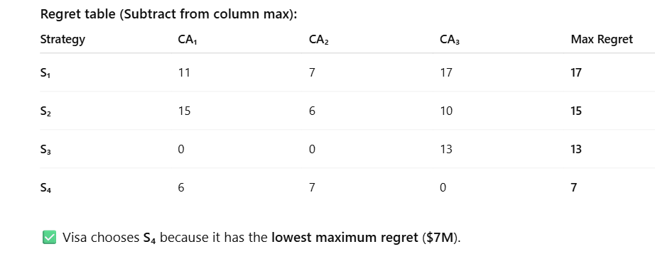
© 2007 Prentice Hall, Inc. All rights reserved.
1–<number>

Slide 36
Decision-Making Styles
Dimensions of Decision-Making Styles
  Ways of thinking
    Rational, orderly, and consistent
    Intuitive, creative, and unique
  Tolerance for ambiguity
    Low tolerance: require consistency and order
    High tolerance: multiple thoughts simultaneously
© 2007 Prentice Hall, Inc. All rights reserved.
6–<number>

Slide 37
Decision-Making Styles (cont’d)
Types of Decision Makers
  Directive
    Use minimal information and consider few alternatives.
  Analytic
    Make careful decisions in unique situations.
  Conceptual
    Maintain a broad outlook and consider many alternatives in making decisions.
  Behavioral
    Avoid conflict by working well with others and being receptive to suggestions.
© 2007 Prentice Hall, Inc. All rights reserved.
6–<number>

Slide 38
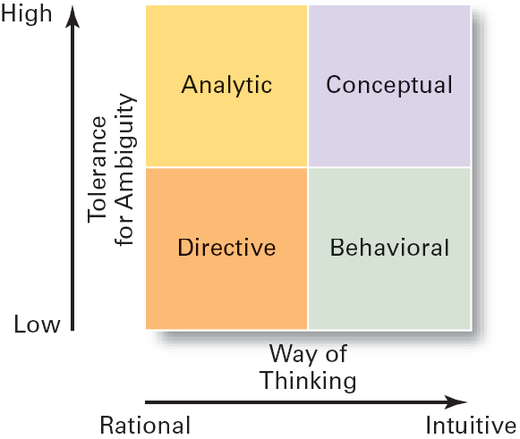
Exhibit 6–12 Decision-Making Matrix
© 2007 Prentice Hall, Inc. All rights reserved.
6–<number>

Slide 39
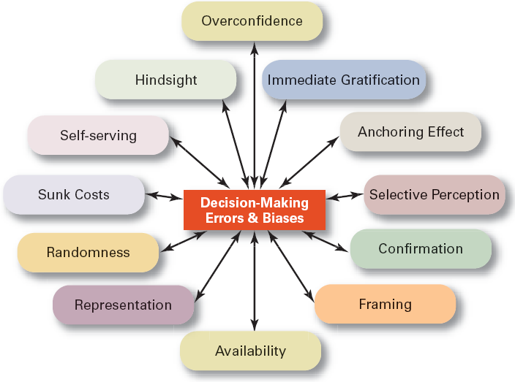
Exhibit 6–13 Common Decision-Making Errors and Biases
© 2007 Prentice Hall, Inc. All rights reserved.
6–<number>

Slide 40
Decision-Making Biases and Errors
Heuristics
  Using “rules of thumb” to simplify decision making.
Overconfidence Bias
  Holding unrealistically positive views of one’s self and one’s performance.
Immediate Gratification Bias
  Choosing alternatives that offer immediate rewards and that to avoid immediate costs.
© 2007 Prentice Hall, Inc. All rights reserved.
6–<number>

Slide 41
Decision-Making Biases and Errors (cont’d)
Anchoring Effect
  Fixating on initial information and ignoring subsequent information.
Selective Perception Bias
  Selecting organizing and interpreting events based on the decision maker’s biased perceptions.
Confirmation Bias
  Seeking out information that reaffirms past choices and discounting contradictory information.
© 2007 Prentice Hall, Inc. All rights reserved.
6–<number>

Slide 42
Decision-Making Biases and Errors (cont’d)
Framing Bias
  Selecting and highlighting certain aspects of a situation while ignoring other aspects.
Availability Bias
  Losing decision-making objectivity by focusing on the most recent events.
Representation Bias
  Drawing analogies and seeing identical situations when none exist.
Randomness Bias
  Creating unfounded meaning out of random events.
© 2007 Prentice Hall, Inc. All rights reserved.
6–<number>

Slide 43
Decision-Making Biases and Errors (cont’d)
Sunk Costs Errors
  Forgetting that current actions cannot influence past events and relate only to future consequences.
Self-Serving Bias
  Taking quick credit for successes and blaming outside factors for failures.
Hindsight Bias
  Mistakenly believing that an event could have been predicted once the actual outcome is known (after-the-fact).
© 2007 Prentice Hall, Inc. All rights reserved.
6–<number>

Slide 44
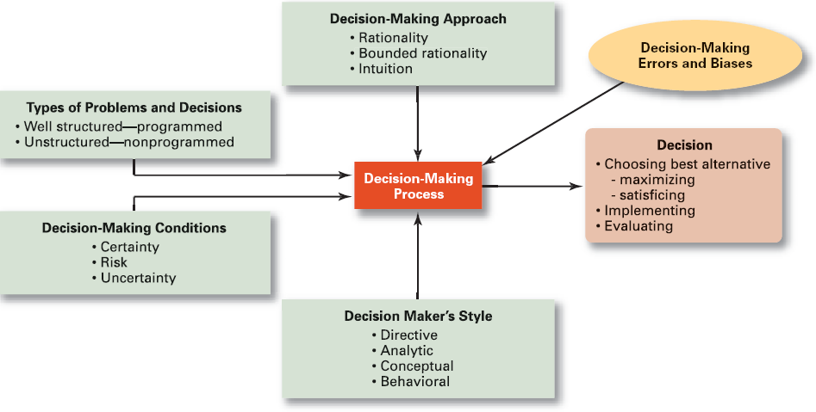
Exhibit 6–14 Overview of Managerial Decision Making
© 2007 Prentice Hall, Inc. All rights reserved.
6–<number>

Slide 45
Decision Making for Today’s World
Guidelines for making effective decisions:
  Understand cultural differences.
  Know when it’s time to call it quits.
  Use an effective decision-making process.
Habits of highly reliable organizations (HROs)
  Are not tricked by their success.
  Defer to the experts on the front line.
  Let unexpected circumstances provide the solution.
  Embrace complexity.
  Anticipate, but also anticipate their limits.
© 2007 Prentice Hall, Inc. All rights reserved.
6–<number>

Slide 46
Characteristics of an Effective Decision-Making Process
It focuses on what is important.
It is logical and consistent.
It acknowledges both subjective and objective thinking and blends analytical with intuitive thinking.
It requires only as much information and analysis as is necessary to resolve a particular dilemma.
It encourages and guides the gathering of relevant information and informed opinion.
It is straightforward, reliable, easy to use, and flexible.
© 2007 Prentice Hall, Inc. All rights reserved.
6–<number>

Slide 47
Terms to Know
decision
decision-making process
problem
decision criteria
rational decision making
bounded rationality
satisficing
escalation of commitment
intuitive decision making
structured problems
programmed decision
procedure
rule
policy
unstructured problems
nonprogrammed decisions
certainty
risk
uncertainty
directive style
analytic style
conceptual style
behavioral style
heuristics
business performance management (BPM) software
© 2007 Prentice Hall, Inc. All rights reserved.
6–<number>

